Slide 1
notatka 7
Tomasz Olczyk

Slide 2
Dziiejsza data 2024-03-06
dwa plus dwa = 4
jak renderować pdf potrzeba najpierw zainstalować instalować tinytex
(Jay 1984)
(Goffman 1956)
cite drive
# oniższy pakiet ma sprawić, że ma działać z pdf ale nie działa install.packages ("tinytex" ) library(tinytex) # moze zadziała jak się użyje tego tinytex::install_tinytex()
biblioteki
library(tidyverse)
R Markdown
This is an R Markdown document. Markdown is a simple formatting syntax for authoring HTML, PDF, and MS Word documents. For more details on using R Markdown see http://rmarkdown.rstudio.com.
When you click the Knit button a document will be generated that includes both content as well as the output of any embedded R code chunks within the document. You can embed an R code chunk like this:
summary(cars)
## speed dist ## Min. : 4.0 Min. : 2.00 ## 1st Qu.:12.0 1st Qu.: 26.00 ## Median :15.0 Median : 36.00 ## Mean :15.4 Mean : 42.98 ## 3rd Qu.:19.0 3rd Qu.: 56.00 ## Max. :25.0 Max. :120.00
Including Plots
You can also embed plots, for example:

Slide 3
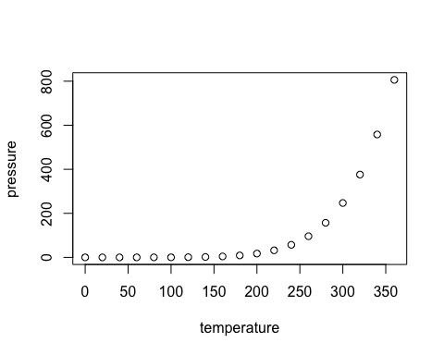
podpis

Slide 4
Note that the echo = FALSE parameter was added to the code chunk to prevent printing of the R code that generated the plot.

Slide 5
Bibliografia
Goffman, Erving. 1956. The Presentation of Self in Everyday Life. Edinburgh: University of Edinburgh Social Science Centre.
Jay, Martin. 1984. Adorno. Cambridge, Mass: Harvard University Press.

